Slide 1
Keynote: Desktop Presentation tool testing types
Taras Travinskyy
01/22/2016

Slide 2
Agenda
Keynote for Mac
Smoke testing
Functional testing
Positive testing
Negative testing
Security testing
Performance testing
Load testing
Stress testing
Localization testing

Slide 3
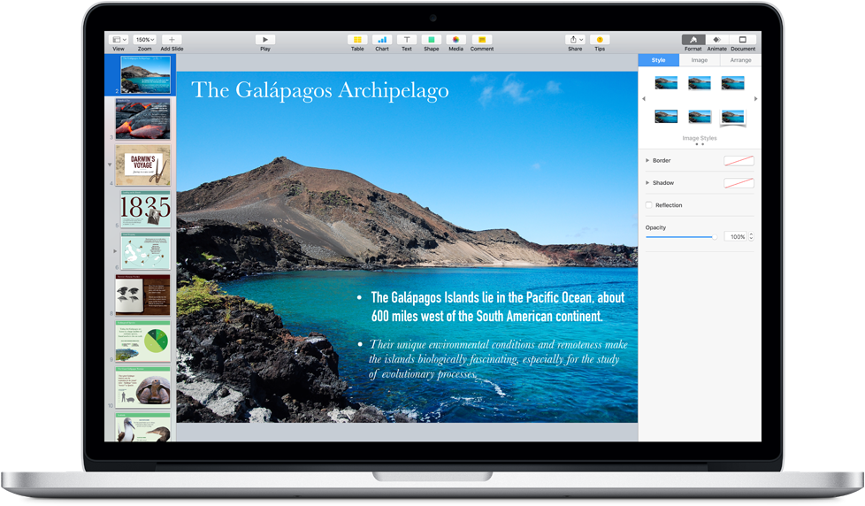
Keynote for Mac
Keynote for Mac makes it simple to create and deliver beautiful presentations. Keynote employs powerful tools and dazzling effects that bring your ideas to life. You can work seamlessly between Mac and iOS devices. And work effortlessly with people who use Microsoft PowerPoint.

Slide 4
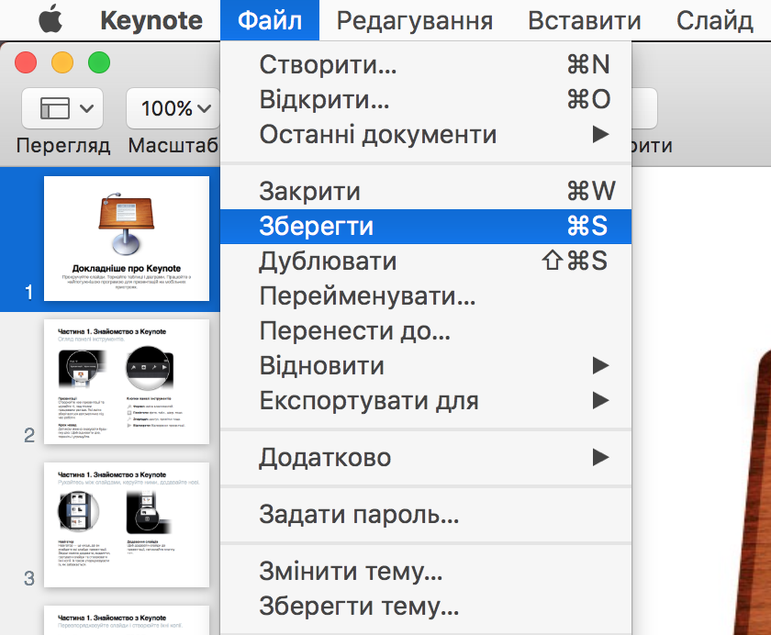
Smoke testing
Requirement: Test new version 6.6.1 (2560) of Keynote application.
Smoke Testing Procedure: quickly check the main Keynote features (run application, create new, open, edit and save presentation).
Defect: There is no ability to Save presentation. Button “Save” is disabled.

Slide 5
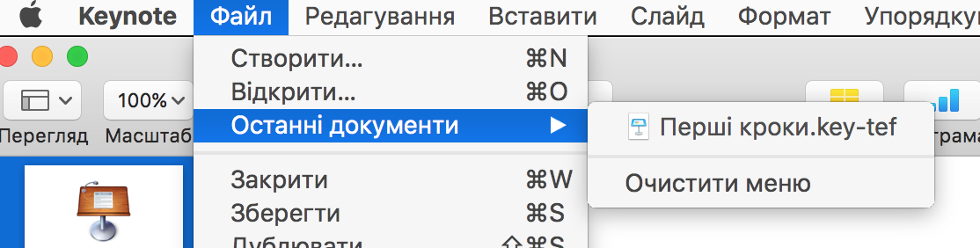
Functional testing
Requirement: User is able quickly reopen last opened documents.
Functional Testing Procedure:
check if menu item present;
open and close different documents- check if the appear in the list and in correct order;
check if document is reopened- it should be excluded from list;
verify list maximum capacity of 10 documents;
check ‘Clear list’ function
Defect: list should consist of 10 last opened documents, but user is able to see and reopen only one last opened document.

Slide 6
Positive testing
Requirement: Application Keynote should open only *.key files of presentations.
Positive Testing Procedure: open *.key file of test presentation.
Defect: File cannot be open.

Slide 7
Negative testing
Requirement: Application Keynote should open only *.key files of presentations.
Negative Testing Procedure: open other than *.key file e.g. *.doc; rename *.doc to *.key and open it.
Defect: Application opens renamed file and crashes.

Slide 8
Security testing
Requirement: Application Keynote should verify password if open protected presentations.
Security Testing Procedure: create new presentation; set password and save file; reopen file- system should open presentation if password is correct.
Defect: Application opens protected files if incorrect password s provided and Cancel button pressed.

Slide 9
Performance testing
Requirement: Each next slide should be delivered on screen less than 1 sec during a presentation of 2-100 slides.
Performance Testing Procedure: create different presentation of 2, 50, 100 slides; run presentation; check time intervals.
Defect: starting from 95 slide
respond time is 1.5-2 seconds.

Slide 10
Load testing
Requirement: Application Keynote should allow open up to 32 files of 100 slides.
Load Testing Procedure: open 1, 16, 32 files of test presentation.
Defect: While opening 25th presentation, application Keynote shows message “Cannot open more files”.

Slide 11
Stress testing
Requirement: Application Keynote should allow open up to 32 files of 100 slides without crashing.
Stress Testing Procedure: open 32, 35, 50 files of test presentation.
Defect: Aplication crashes starting from 33 presentation. And all unsaved changes are lost.
Data should not be lost even in stress situations. If possible, system crash also should be avoided.

Slide 12
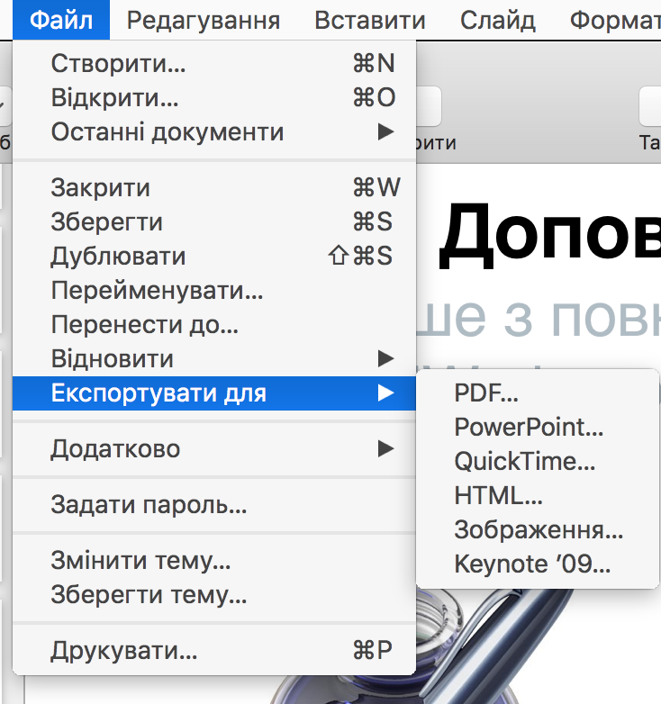
Localization testing
Requirement: Verify that ‘File’-menu is translated to Ukrainian
Localization Testing Procedure:
Test all menu and sub-menus items in ‘File’ menu if they are translated to Ukrainian; check whether they are localized and not truncated
Defects:
“Rename” item is truncated on Ukrainian Locale;
“Print” item is not translated and still appears in English under Ukrainian locale.
Notes:
Localization is the process of adapting a globalized application to a particular culture/locale. Localization includes the translation of the application user interface and adapting graphics for a specific culture/locale. The localization process can also include translating any help content associated with the application.
Localization (L10N) testing checks how well the application under test has been Localized into a particular target language.
Because every country’s language, culture, currency, taxes and standards are different, it’s imperative for companies to test how well their applications perform with different aspects of international culture.

Slide 13
Thank you
US OFFICES
Austin, TX
Fort Myers, FL
Boston, MA
Newport Beach, CA
Salt Lake City, UT
EUROPE OFFICES
United Kingdom
Germany
The Netherlands
Ukraine
Bulgaria
EMAIL
info@softserveinc.com
WEBSITE:
www.softserveinc.com
USA TELEPHONE
Toll-Free: 866.687.3588
Office: 239.690.3111
UK TELEPHONE
Tel: 0207.544.8414
GERMAN TELEPHONE
Tel: 0692.602.5857

